Slide 1
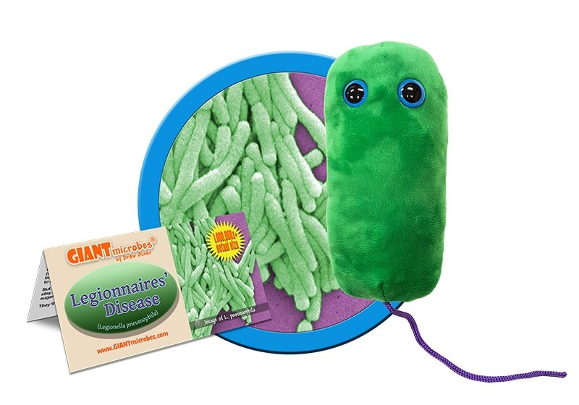
Legionellosis Urban vs Rural Risk in Ohio
David Hibler
https://www.giantmicrobes.com/us/products/legionnaires.html

Slide 2
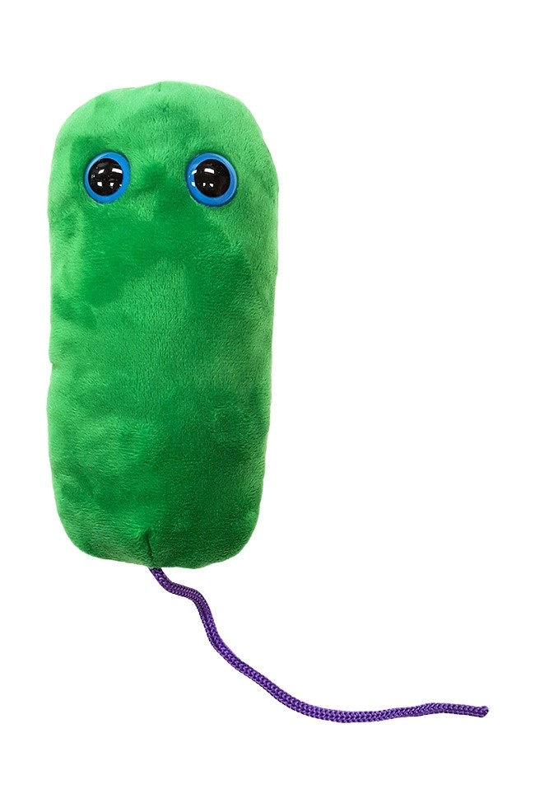
Hazard
Legionella is an aerobic, non-spore-forming, gram-negative, pleomorphic, flagellated, non-communicable disease causing, bacterium normally found associated with freshwater amoebae, and is also the causal agent of a potentially fatal form of pneumonia in humans known as Legionaries' Disease (LD).
Legionella infections can result in Legionellosis which is a set of two respiratory diseases outcomes;
Legionnaires' disease (LD), which is a community pneumonia and has a mortality rate of up to 30% (as high as 80%, with extreme cases)
Pontiac Fever, a non-pneumonia, flu-like illness that often self-limits after two to five days.

Slide 3
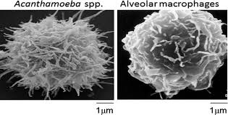
Hazard
Siddiqui, Ruqaiyyah, and Naveed Ahmed Khan. "Acanthamoeba is an evolutionary ancestor of macrophages: a myth or reality?." Experimental parasitology 130.2 (2012): 95-97.
It can enter and thrive within the biofilm rich environments of our water distribution systems, which can lead to human exposure.
Shower heads, faucets, toilets, etc… aerosolize water particles and bacteria.
Human infections can happen after aerosolized particles are inhaled into the lungs.
Alveolar macrophages are structurally and behaviorally similar to protozoan host and can be parasitized.
Pneumonia
Legionaries’ Disease

Slide 4
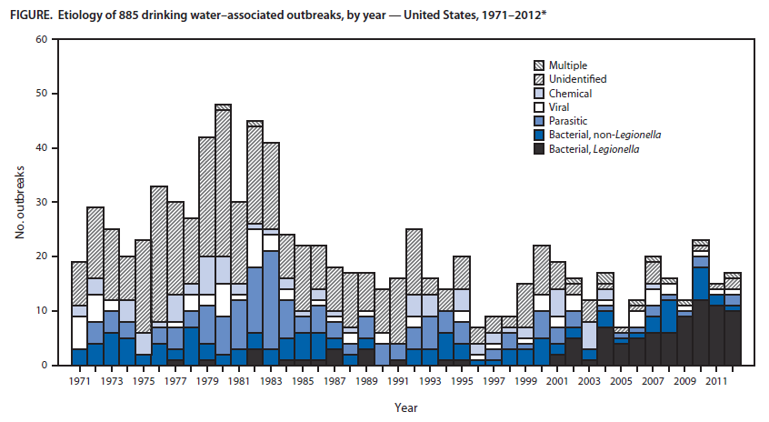
Hazard
Legionella infections are rising dramatically, with more than 50,000 cases reported annually in the US.
Legionella is now the most common cause of all reported water-associated illnesses in the US.
While the overall burden of water born disease outbreaks has been declining in the US since the 1970s, the proportion of outbreaks that are associated with legionella have been increasing
Beer, Karlyn D., et al. "Surveillance for waterborne disease outbreaks associated with drinking water—United States, 2011–2012." MMWR. Morbidity and mortality weekly report64.31 (2015): 842.

Slide 5

Population: Urban VS Rural
Water Age
Rural systems generally have older water age than Urban.
Higher concentrations in urban distribution water
Disease Reports

Slide 6
Ohio Counties
Population and Infections by county
Data:
US Census Bureau (https://www.census.gov/quickfacts/OH)
World Population Review (http://worldpopulationreview.com)
Ohio Department of Health (https://odh.ohio.gov/wps/portal/gov/odh/know-our-programs/infectious-diseases/Reports/2017-annual-summary)

Slide 7
Ohio Counties
Population and Infections by county
Reported cases may underrepresent actual rates of infection.

Slide 8


Ohio Counties
Population and Infections by county
Reported cases may underrepresent actual rates of infection.

Slide 9


Ohio Counties
Population and Infections by county
Reported cases may underrepresent actual rates of infection.

Slide 10
Ohio Counties
Population and Infections by county
Correlation P-Values
Test | Infections vs Population | Infections vs Pop_density | Infections vs Ln_Pop | Infections vs Ln_Pop_density
Pearson | 1.43E-39 | 2.11E-30 | 5.44E-12 | 1.10E-11
Kendall | 4.89E-14 | 1.33E-13 | 4.89E-14 | 1.33E-13
Spearman | 1.73E-15 | 1.07E-14 | 1.73E-15 | 1.07E-14
Rates of Legionellosis were very significantly related to population size, density and the natural logs of both. Population size did seem to have the highest degree of significance. So this does provide evidence that this non-communicable disease poses a greater public health risk in high population environments (urban), than it is in less populated environments (rural). However, this data does not provide much more insight beyond that.
The trends on the scatter plots do look to be non-linear, possibly suggesting that more heavily populated areas add compounding effects to infection rates. However additional research and analysis would be needed to determine what effects are impacting these results.

Slide 11
Legionellosis Urban vs Rural Risk in Ohio
David A. Hibler
GitHub: https://github.com/dhibler/Legionellosis-ohio.git
Personal website: https://davidhibler.netlify.com/
Twitter: @DavidHibler4

Slide 12
References
Allaire, Maura, Haowei Wu, and Upmanu Lall. 2018. “National Trends in Drinking Water Quality Violations.” Proceedings of the National Academy of Sciences 115 (9): 2078–2083.
Beer, Karlyn D., Julia W. Gargano, Virginia A. Roberts, Vincent R. Hill, Laurel E. Garrison, Preeta K. Kutty, Elizabeth D. Hilborn, Timothy J. Wade, Kathleen E. Fullerton, and Jonathan S. Yoder. 2015. “Surveillance for Waterborne Disease Outbreaks Associated with Drinking Water-United States, 2011-2012.” MMWR. Morbidity and Mortality Weekly Report 64 (31): 842–848.
Brunk, Doug. 2017. “Cases of Legionnaires’ Continue to Rise in the United States.” Chest Physician, October 15, 2017. https://www.mdedge.com/chestphysician/article/149407/healthcare-acquired-infections/cases-legionnaires-continue-rise-united.
Butler, Colin D., Jane Dixon, and Anthony G. Capon. 2015. Health of People, Places and Planet: Reflections Based on Tony McMichael’s Four Decades of Contribution to Epidemiological Understanding. ANU Press.
Centers for Disease Control and Prevention (CDC). 2011. “Legionellosis --- United States, 2000-2009.” MMWR. Morbidity and Mortality Weekly Report 60 (32): 1083–86.
Challacombe, S. J., and L. L. Fernandes. 1995. “Detecting Legionella Pneumophila in Water Systems: A Comparison of Various Dental Units.” The Journal of the American Dental Association 126 (5): 603–608.
Che, D., B. Decludt, C. Campese, and J. C. Desenclos. 2003. “Sporadic Cases of Community Acquired Legionnaires’ Disease: An Ecological Study to Identify New Sources of Contamination.” Journal of Epidemiology & Community Health 57 (6): 466–69. https://doi.org/10.1136/jech.57.6.466.
Council, National Research, Division on Earth and Life Studies, Commission on Life Sciences, and Board on Environmental Studies and Toxicology. 2000. Strategies to Protect the Health of Deployed U.S. Forces: Assessing Health Risks to Deployed U.S. Forces -- Workshop Proceedings. National Academies Press.
DESA, UN. 2014. “World’s Population Increasingly Urban with More than Half Living in Urban Areas.” Retrieved March 17: 2018.
EPA, U. "Exposure factors handbook 2011 edition (final)." Washington, DC (2011).
Fitzgeorge, R. B., et al. "Aerosol infection of animals with strains of Legionella pneumophila of different virulence: comparison with intraperitoneal and intranasal routes of infection." Epidemiology & Infection. 90 (1983).
Hamm, Trent. "Do You Really Save Money By Not Always Flushing?." The Christian Science Monitor. N. p., 2010. Web. 10 Mar. 2019. https://www.csmonitor.com/Business/The-Simple-Dollar/2010/0420/Do-You-Really-Save-Money-By-Not-Always-Flushing
Hedges, L. J., and D. J. Roser. 1991. “Incidence of Legionella in the Urban Environment in Australia.” Water Research 25 (4): 393–99. https://doi.org/10.1016/0043-1354(91)90075-2.
Heijnsbergen, E. van, A. van Deursen, M. Bouwknegt, J. P. Bruin, A. M. de Roda Husman, and J. a. C. Schalk. 2016. “Presence and Persistence of Viable, Clinically Relevant Legionella Pneumophila Bacteria in Garden Soil in the Netherlands.” Applied and Environmental Microbiology 82 (17): 5125–31. https://doi.org/10.1128/AEM.00595-16.
Heijnsbergen, E. van, A. M. de Roda Husman, W. J. Lodder, M. Bouwknegt, A. E. Docters van Leeuwen, J. P. Bruin, S. M. Euser, J. W. den Boer, and J. a. C. Schalk. 2014. “Viable Legionella Pneumophila Bacteria in Natural Soil and Rainwater Puddles.” Journal of Applied Microbiology 117 (3): 882–90. https://doi.org/10.1111/jam.12559.
Hines, Stephanie A., et al. "Assessment of relative potential for Legionella species or surrogates inhalation exposure from common water uses." Water research 56 (2014): 203-213.
http://worldpopulationreview.com
https://odh.ohio.gov/wps/portal/gov/odh/know-our-programs/infectious-diseases/Reports/2017-annual-summary
https://www.census.gov/quickfacts/OH
Siddiqui, Ruqaiyyah, and Naveed Ahmed Khan. "Acanthamoeba is an evolutionary ancestor of macrophages: a myth or reality?." Experimental parasitology 130.2 (2012): 95-97.
Mraz, Alexis L., and Mark H. Weir. 2018. “Knowledge to Predict Pathogens: Legionella Pneumophila Lifecycle Critical Review Part I Uptake into Host Cells.” Water 10 (2): 132. https://doi.org/10.3390/w10020132.
"Showers | Home Water Works." Home-water-works.org. N. p., 2019. Web. 10 Mar. 2019. https://www.home-water-works.org/indoor-use/showers
"Faucet | Home Water Works." Home-water-works.org. N. p., 2019. Web. 10 Mar. 2019. https://www.home-water-works.org/indoor-use/faucet

